Slide 1
The Supreme Court

Slide 2
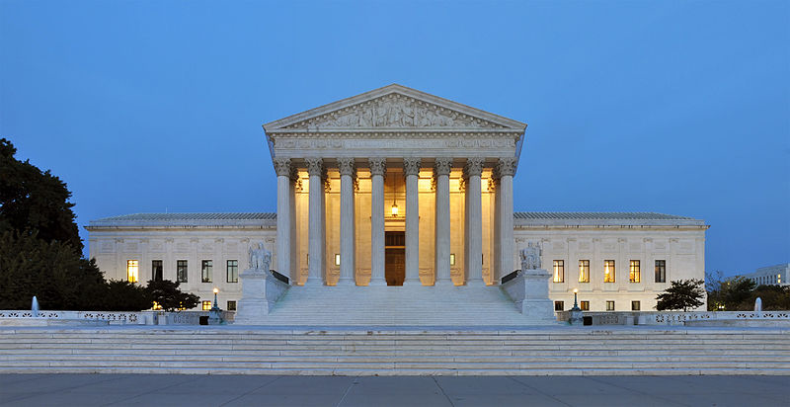
Purpose
Article 3 of the Constitution lays out the powers of the Judicial Branch.
Interprets laws and ensures that they are applied fairly
“The Judicial power of the United States shall be vested in one supreme court, and in such interior courts as the congress may from time-to-time ordain and establish.”

Slide 3
A Dual System
Under the Articles of Confederation, there was no national court system. Any law made by the Confederation was left up to the state courts to interpret which led to contradictory rulings and uncertainty about what the law really was.
The Constitution created a duel system: a justice system separated into state courts and a national (federal) court.
There are state courts for state level issues and federal courts for federal level issues, not all courts can decide all cases

Slide 4
Judiciary Act of 1789- Structure
The original structure was left vague by the founders (by doing this, they avoided opposition in the ratification process).
Article 3: “The judicial power of the United States shall be vested in one Supreme Court, and in such inferior courts as the Congress may from time to time ordain and establish.”
Judiciary Act of 1789- Proposes the three-tiered system:
1) District Courts
2) Circuit Court of Appeals
3) Supreme Court.

Slide 5
Structure
SCOTUS
(Supreme Court of the United States)
(80%-85%) (15%-20%)
appeal appeal
State Supreme Court
U.S. Court of Appeals appeal
appeal Intermediate Court of Appeals
appeal
U.S. District Court Municipal or County Court
Federal Court System State Court System
( ~ 1 million cases/year) (~ 30 million cases/year)

Slide 6
Jurisdiction
Jurisdiction: Court’s authority to hear and decide cases.
State Jurisdiction: authority to decide cases over state laws in which the federal government doesn’t have exclusive jurisdiction.
Municipal and County Courts => Intermediate courts => State Supreme Court
Exclusive Jurisdiction: authority of a court to hear a case which excludes other courts from hearing that case.
Federal Jurisdiction: authority of a court to hear cases that apply strictly to federal laws.
District Courts => Circuit Court of Appeals => and Supreme Court

Slide 7
Federal Jurisdiction
What does Exclusive Jurisdiction cover?
Involving Constitution Interpretation
Violations of Federal Law
Controversies between states and Parties and states
Suits involving the federal government (if you sue the federal government)
Cases involving foreign countries

Slide 8
Who Exercises Power
Why are judges appointed?
1. Legal Expertise
2. Senatorial courtesy: traditionally, the senators do not approve of a appointment of a judge (primarily at the district level) if the senator from the state of that judge or from the party of the president wants to deny that appointee.
This forces the president to have to consult the senators first or make decisions off their recommendations.
3. Party Affiliation-Political philosophy
4. Judicial Philosophy:
Judicial restraint: the belief that a judge should interpret the Constitution according to the framers’ original intention.
Judicial activism: the belief that judges can adapt the meaning of the Constitution to meet the demands of contemporary realities and interpret the Constitution as an evolving document.

Slide 9
District Courts
“Law and Order Court”- Trial Court
Witnesses, Juries, Evidence
94 federal District courts
Original Jurisdiction: authority to hear cases for the first time
In the absence of a Supreme Court ruling to the contrary, the lower federal courts determine what the law is by setting precedents in their rulings.
In serious criminal cases, district courts convene panels, grand juries, to hear evidence of a possible crime and to recommend whether the evidence is sufficient to file criminal charges.
District courts hear bankruptcy cases. Bankruptcy is a legal process by which persons who cannot pay money they own others can receive court protection and assistance in settling their financial problems.
Judges preside over a trial. S/he makes sure trials follow proper legal procedures to ensure fair outcomes. If participants refuse a jury, the judge can act as the jury.

Slide 10
United States Circuit Court of Appeals
Appellate Jurisdiction: authority to hear a case appealed from a lower court.
Review the decisions of lower courts
Decisions:
Uphold the original decision
Reverse the original decision
Remand- send back to lower courts for retrial.
Not deciding guilt or innocence. Examining if the lower court made the correct legal interpretation.
Appeals courts don’t have to take cases.
Appellate court- Only guilty defendants can appeal. Those found not guilty are let free. In civil cases (questions of civil rights), either side can appeal.
- Few cases are successfully appealed. In 2009, only 9% were successfully appealed.
- They do not retry cases. They review procedural errors.
- Decisions of one circuit court is not binding to other circuit courts.

Slide 11
Common Law
Opinion- written explanation by judge or group of judges of the legal thinking behind a decision.
The Opinion sets the precedent.
Precedent: an earlier decision or action that guides future decisions and actions.
Precedent is not law, but it must be followed due to stare decisis (stair-ray-d-si-ses).
Stare Decisis: the rule stating that precedent must be followed providing a legal system with predictability and stability.
Followed by the same courts or lower courts.

Slide 12
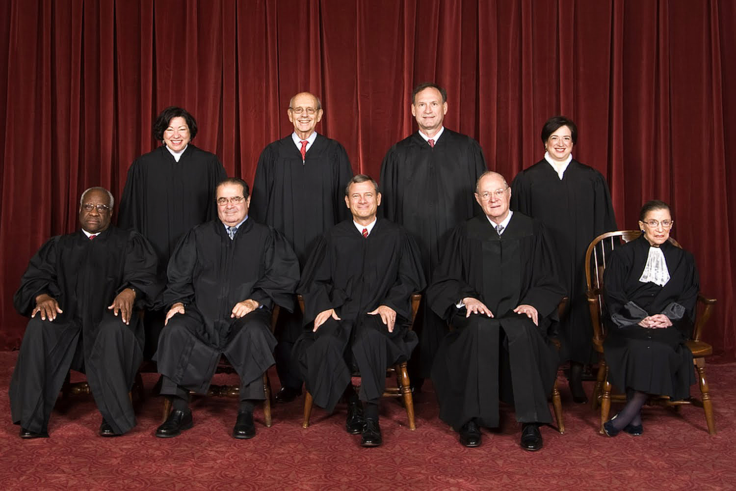
Supreme Court of the United States (SCOTUS)
(Back Row): Sonia Sotomayor, Stephen Breyer, Samuel Alito, Elena Kegan (Front Row): Clarence Thomas, Antonin Scalia (now deceased), John Roberts, Anthony Kennedy, and Ruth Bader Ginsburg

Slide 13
SCOTUS
9 Justices (1 of which is Chief Justice)
Majority of Justices is needed to decide a case.
Qualifications?
Removal: hold position for life (good behavior)
Impeachment
Retire
Death ☹
Appointed by the President and approved by the Senate
Purpose: proper interpretation of the law…not innocence or guilt
“Equal Justice for All” = Their decisions (precedents) will protect every citizen equally, commonly (Common Law)

Slide 14
Precedent for Judicial Review- Marbury v. Madison
Judicial Review: the power to determine whether any federal, state, or local law or government action is constitutional or not.
Question: If a law by the legislative branch conflicts with the Constitution, can it be determined to be unconstitutional by the Judicial Branch?
Answer: Yes!
Precedent: The Constitution is the highest power in the land, and the Judicial Branch has the power to interpret whether the legislative or executive branch has violated the Constitution…hence, confirming the power of Judicial Review.
The purpose of judicial review is as a check:
- “Limitations [on the powers of government]…can be preserved in practice no other way than through…courts of justice, whose duty it must be to declare all acts contrary to the manifest tenor [obvious meaning] of the Constitution void. Without this, all the reservations of particular rights or privileges would amount to nothing.”
- Alexander Hamilton, The Federalist No. 78

Slide 15
Expanding Federal Power- John Marshall’s Court
John Marshall expended the power of the Judicial Branch and the federal government by using judicial review in Marbury v. Madison.
This action would create a precedent for an expansion of federal power in the judicial branch and, eventually, the power would continue to expanded to other federal branches in court decisions like McCulloch v. Maryland and Gibbons v. Ogden.

Slide 16
Process of Scotus to hear a case (7 step process)
1. SCOTUS must be informed of a case in which to review.
Petition of Certiorari (sir-shore-rare-eye):
Formal application by a party to have the Supreme Court of the United States to review their case.
Latin for “to be informed”
SCOTUS has the discretion to approve or deny any such application.
~9000 petitions/year => SCOTUS => avg. 67-80 cases/year = less than 1%
2. Meeting by Justices to choose cases
Rule of Four: Four Justices must agree to HEAR a case (not decide one)
Issue a writ of certiorari: an order to a lower court to deliver its record in a case to a higher court for review.
Accepted cases go on the DOCKET: calendar with a list of cases
Try to pick cases that have national implications, not specific individuals or groups.

Slide 17
Process of Scotus to hear a case (7 step process)
Written Arguments-
Briefs: written document explaining one side’s position on the case.
Amicus Brief: a brief prepared by outside parties who have an interest in the case.
Oral Arguments- 30 minute oral presentation of each side’s position with questions from the Justices.
Conference- All Justices meet in their “chambers” (no one else can attend conference).
Chief Justice resides over conference.
Vote on case.
More cases are 9-0 than 5-4. What does this tell us?

Slide 18
Process of Scotus to hear a case (7 step process)
6. Opinion writing-
Majority Opinion: presents views of the majority of justices. Explains how the court came to its decision, and acts as the precedent for the case.
Dissenting Opinion: the arguments which show views contrary to the majority.
Concurring Opinion: the opinion of a member (members) who voted with the majority, but for a different interpretation of the law.
7. Announcement- Public announcement of the decision.

Slide 19
Driving forces behind judicial decisions
Precedent, but the court can overrule a former decision (example: Plessy v. Ferguson and Brown v. Board)
Legal views (strict interpretation/loose interpretation- what is the role of the court)
Personal beliefs
State of society (example: marriage equality)

