Slide 1
The Executive Branch
Unit 7

Slide 2
President of the United States
Qualifications:
35 years old
“Native Born” American Citizen (not defined)
Resident of the United States for 14 years

Slide 3
Voting for President
Process- Electoral College (process not an actual place) elects the President based on popular vote in each state
Total possible votes- 538, 1 for every Senator/Rep in each state, plus 3 for D.C.
How many votes are needed to have a majority?
270 are needed to have a majority.
Who chooses the president if there is no majority?
If no candidate wins that number the House of Reps votes as a whole state between the top 3. D.C. gets no vote and 26 states would be needed to win. Only happened twice 1801 and 1825…both times involved an Adams presidency.

Slide 4
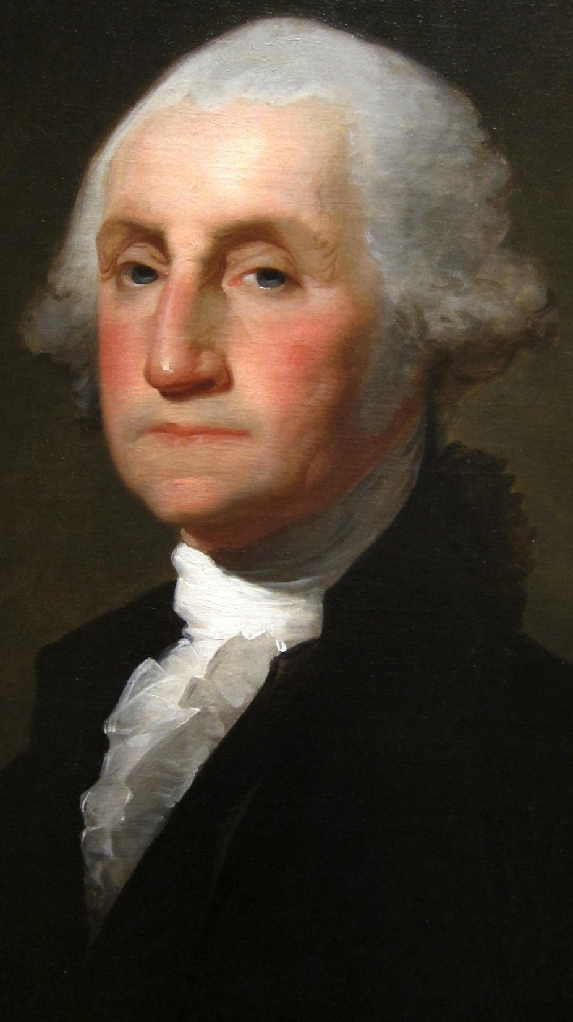
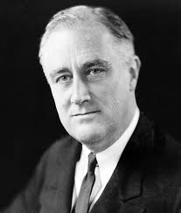
Term in Office
How long is a president’s term?
22nd Amendment
What is the term limit?
Why?
Who set the precedent for the limit? Why was this important?
Who broke it?
Maximum years in office?

Slide 5
Vice President
"My country has in its wisdom contrived for me the most insignificant office that ever the invention of man contrived or his imagination conceived.”- John Adams
President of the Senate- Break Ties
Presidential Succession Act of 1947- VP is second in line
25th Amendment-
If VP is removed, the President appoints new VP.
If President is incapacitated, how power is transferred to VP.

Slide 6
Constitutional Powers
Executive Powers:
Appointment and Removal: President has to power to appoint people to fill top posts which numbers nearly 3000. About 1/3 are approved by the Senate, and most appointees serve “serve at the pleasure of the president” which means they can be removed at any time the president wants to.
Executive Orders: The president has the power to issue executive orders (a formal rule or regulation instructing executive branch officials on how to carry out their jobs). Example: making appropriate accommodations for people with disabilities, “Don’t Ask, Don’t Tell,” and raising minimum wage to $10.10 for all offices.
Executive Power: the power of the president to refuse to disclose information to Congress or courts. There is a dispute by the other branches.

Slide 7
Constitutional Powers
Legislative Powers:
Budget: The president sets the budget, but requires congressional approval.
Propose Legislation: during the State of the Union address and throughout their time in office, the president can propose legislation to Congress.
Veto: The president has a say in legislation by having the power to veto or say “no” to a bill, or by signing it into law.
Judicial Powers:
Nomination of Judges: The president has the power to nominate judges, which will give him/her the power to influence government long after they are out of office.
Alter sentencing: President has the power to reprieve (postpone the carrying out of a sentence or the length of a term) or pardon (releases a convicted criminal from having to fulfill a sentence). * Has no power over state crimes*

Slide 8
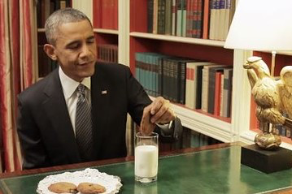
Checks on Presidential Power
Judicial Branch: the power of judicial review to determine if a presidential action is constitutional or not.
Legislature: block presidential appointments, override veto, power of “the purse,” and impeachment.

Slide 9
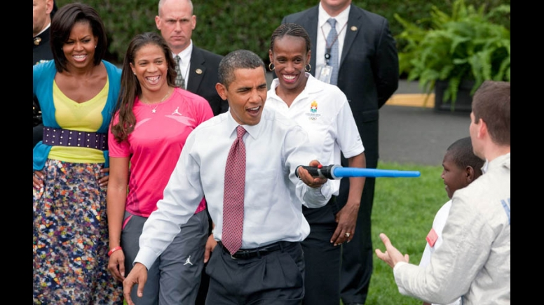
Roles of the President
Chief Executive= “To take care that laws are faithfully executed.”
In charge of Presidential cabinet and the departments they represent to execute federal law.
Departments: Agriculture, Commerce, Defense, Education, Energy, Health and Human Services, Homeland Security, Housing and Urban Development, Justice, Labor, State, Interior, Treasury, Transportation, and Veterans Affairs

Slide 10
Roles of the President
Chief Diplomat (Foreign Policy Leader)
Directs foreign policy
Commander-in-Chief
Head of the military- highest military rank
Backs up foreign policy with military power
War Powers Resolution of 1973: President must notify Congress 48 hours before s/he sends troops into a conflict, and troops must begin to come home after 60 days without Congressional support (30 days to come home). Total of 90 days.
Head of State
Living symbol of our sovereignty (Constitution)- Representative of a nation to other nations.
Example: Monarch in England

Slide 11
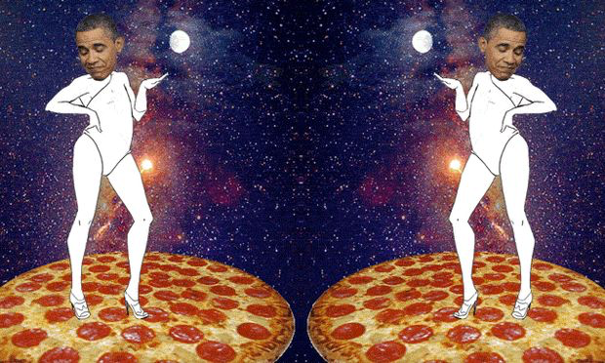
Roles of the President
Economic Leader
Plans the federal budget
Party Leader
Represents the highest position in their political party

Slide 12
Foreign Policy
A nation’s plan for how it will achieve goals with other nations- Goals:
National Security: essential to the function of government.
International Trade: Economic prosperity and influence over other nations.
Promote Peace (sometimes)
Promote Democracy (…sometimes)

Slide 13
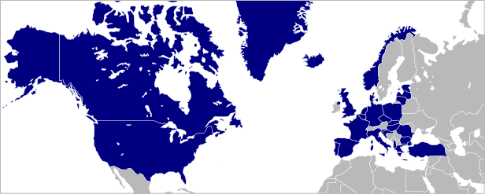
Tools to Achieve Foreign Policy
Treaties and Executive Agreements: Agreements between nations.
Example: NATO- North Atlantic Treaty Organization

Slide 14
Tools to Achieve Foreign Policy
2. Appointing Ambassadors
3. International Trade:
Trade Sanction: one country punishes another by cutting off trade. (Example: U.S. and Cuba)
Embargo: when a group of countries punishes another by cutting off trade. (Example: Iran. Why?)
Determine tariffs (taxes) on other countries or the creation of free trade.
4. Military Force

Slide 15
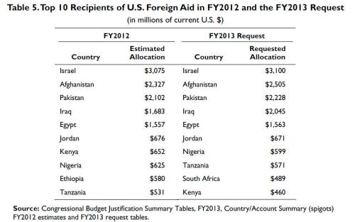
Tools to Achieve Foreign Policy
5. Foreign Aid

Slide 16
The Administration
The President’s Administration is made up of all the people who work for the executive branch from local postal worker to the president.
Executive Office of the President (EOP):
The White House Office: president’s key personal and political staff. Chief of Staff.
National Security Council (NSC): brings together the top military, foreign affairs, and intelligence officials to coordinate national security policy.
Council of Economic Advisors (CEA): Members who examine the economy to help formulate economic policy.
Office of Management and Budget (OMB): Helps to oversee executive branch and develop the budget.

Slide 17
Bureaucracy
Bureaucracy: complex systems with many departments, many rules, and people in a chain of command.
The Cabinet:
Heads of Executive departments (responsible for carrying out laws, administering programs, and making regulations in their particular area).
Not mentioned in the Constitution
16 official cabinet members (including the vice president)

Slide 18
Bureaucracy
Executive Departments
Department Agencies and Bureaus (FBI, JD, IRS).
Independent Agencies: government agencies created by Congress which operate separately from the executive departments.
Independent executive agencies: under the power of president (NASA-National Aeronautical and Space Administration).
Independent regulatory Commissions: regulate a part of the economy (FCC- Federal Communications Commission)
Government Corporations: Run like businesses but run by the government (USPS- United States Postal Service, Amtrak)

Slide 19
Government Workers
Civil Service Workers: civilians who carry out the work of the federal government.
They are hired through a competitive process => leads to a merit based system
Political Appointees: federal employees appointed by the president or president’s cabinet for reasons that they deem appropriate.
Leads to a spoils system (government jobs given out by the president usually as political rewards to people who supported his/her policies or the campaign).
Federal contracts were given out as favors at the expense of the people.
Quick turnover from administration to administration leads to an inefficient and inexperienced government system.
Reform acts: Pendleton Act (1883), Civil Service Reform Act (1978), U.S. Merit Systems Protection Board

Slide 20
Financing the Government- Revenue
Paying for government-
Income Tax: 16th Amendment- tax people’s income
Progressive Tax- rate increases as the amount that is subject to taxation increases.
Payroll taxes- Money withheld from a person’s paycheck for a specific program (social security, Medicaid, or Medicare)
Estate Taxes
Excise Taxes (gas tax) and Tariffs (foreign goods)

Slide 21
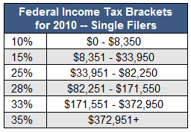
Progressive Tax

Slide 22
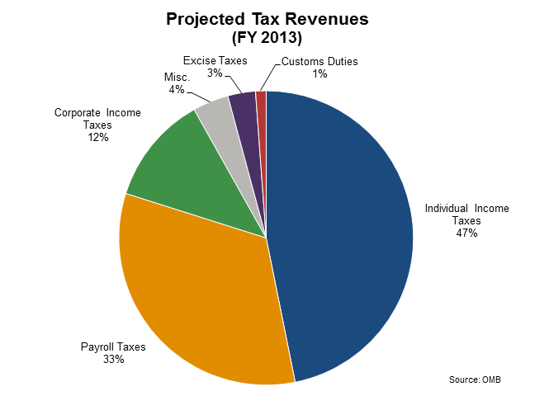

Slide 23
Financing the Government- Spending
Government Spending-
Mandatory Spending: spending required by law and subject to the annual budget process.
Discretionary Spending: spending subject to the annual budget process.

Slide 24
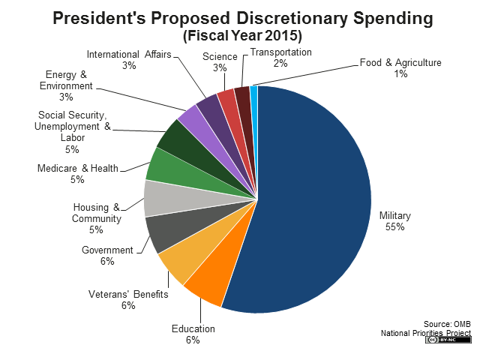

Slide 25
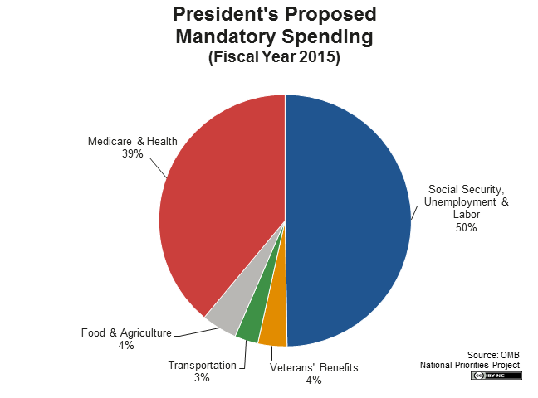

Slide 26
