Slide 1
Colonies in Crisis
Focus Question:
What major social and political crises rocked the colonies in the late seventeenth century?

Slide 2
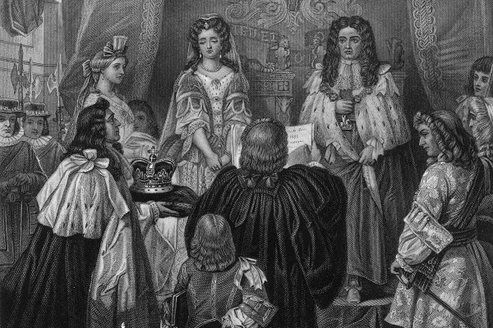
Colonies in Crisis
The Glorious Revolution

Slide 3
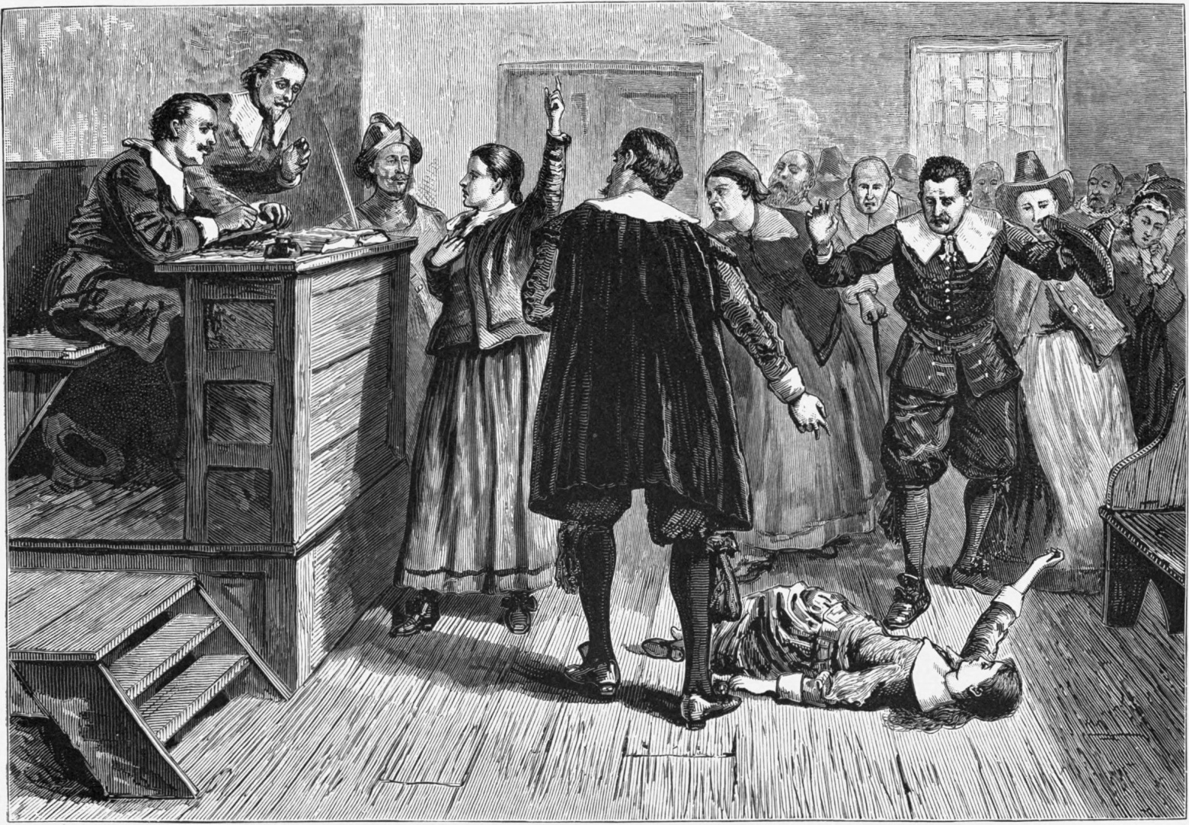
Colonies in Crisis
The Salem Witch Trials

Slide 4
The Growth of Colonial America
Focus Question:
What were the directions of social and economic change in the eighteenth century colonies?

Slide 5
The Growth of Colonial America
A Diverse Population
English migration slows down
Non-English European migration increases
More slaves are brought in

Slide 6
The Growth of Colonial America
The German Migration
More than 100,000 Germans migrate to America
Religious Diversity
Homogeneous communities
Still more diverse than England

Slide 7
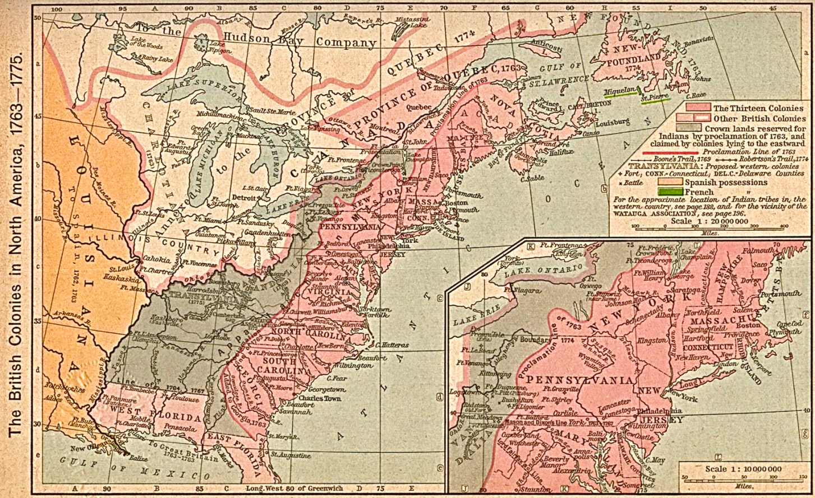
The Growth of Colonial America
Native American life in Transition
Regional Diversity

Slide 8
The Growth of Colonial America
The Consumer Revolution
Colonial Cities
Most of Americans lived in rural areas
Philadelphia was largest city in America at 30,000

Slide 9
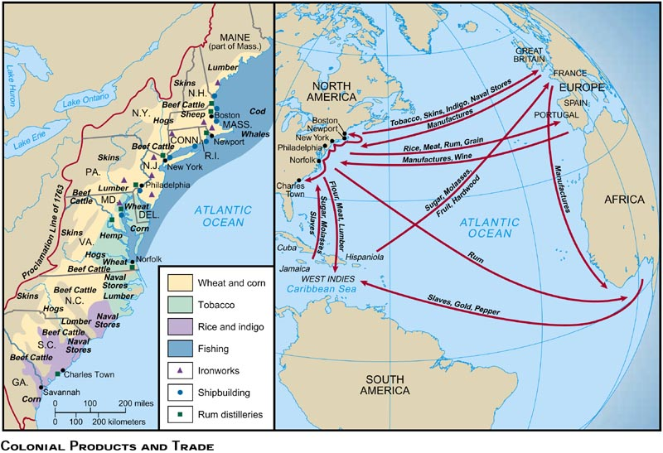
The Growth of Colonial America
An Atlantic World

Slide 10
Social Classes in the Colonies
Focus Question:
How did patterns of class and gender roles change in eighteenth-century America?

Slide 11
Social Classes in the Colonies
The Colonial Elite
Anglicanization

Slide 12
Social Classes in the Colonies
Poverty in the Colonies
Colonial elites believed in “Superiors” and “Dependants”
Fewer poor than in England
Still became a larger population over time

Slide 13
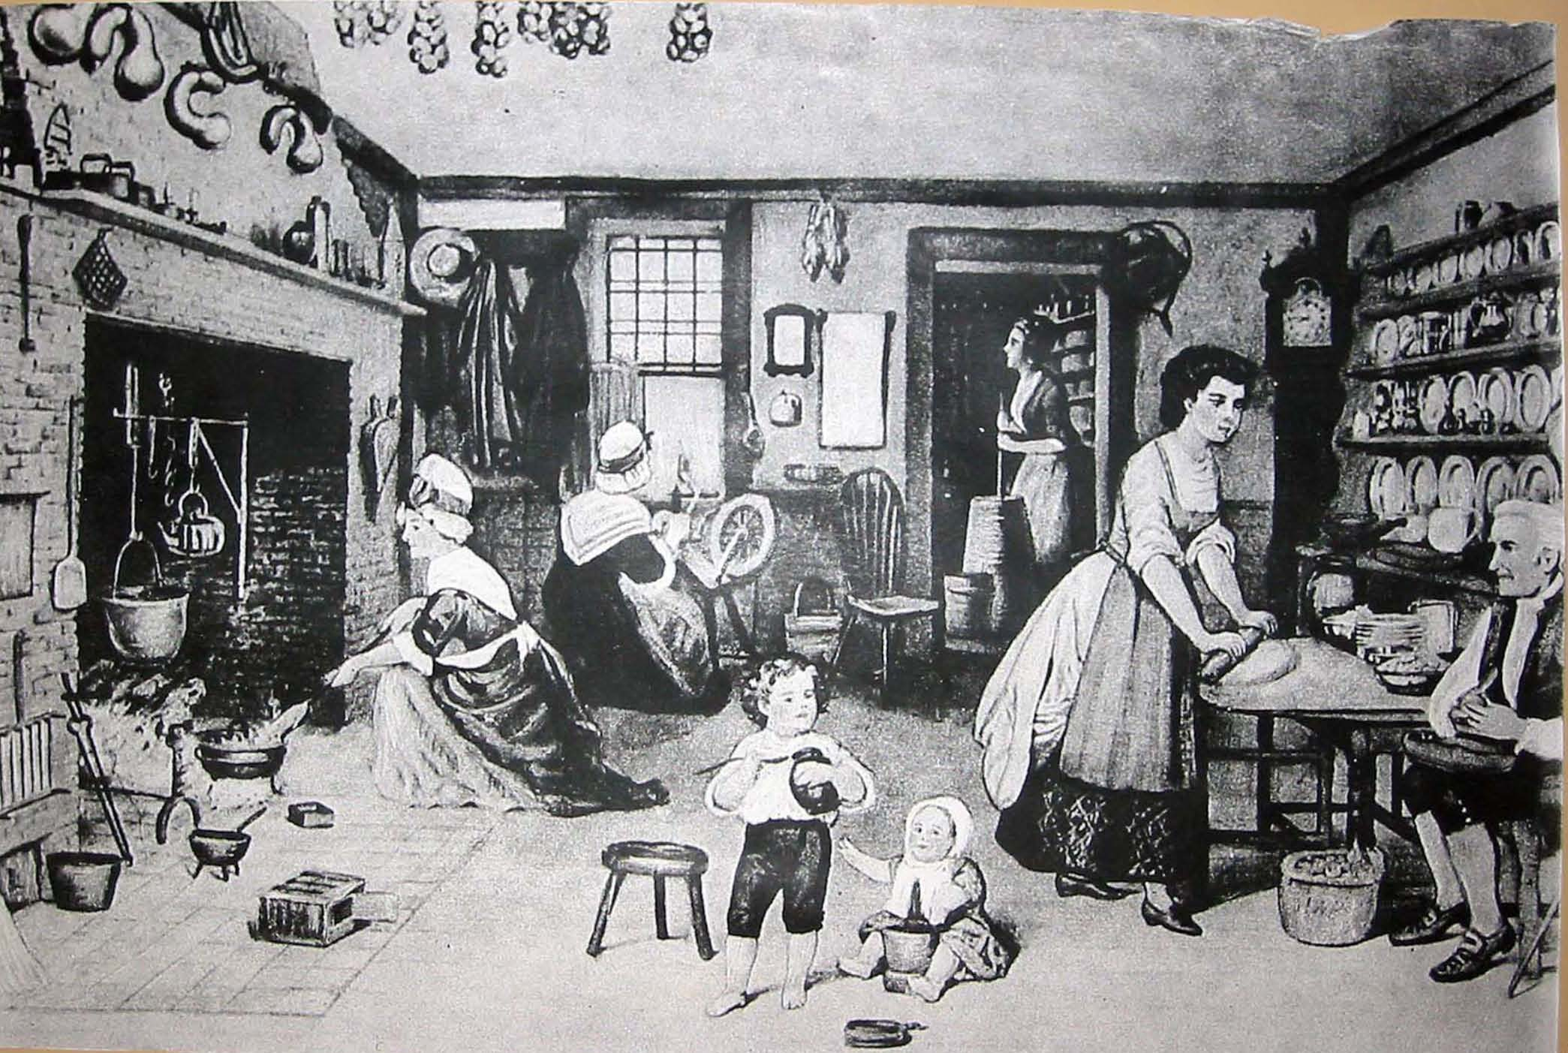
Social Classes in the Colonies
The Middle Ranks
Women and the Household Economy

Slide 14
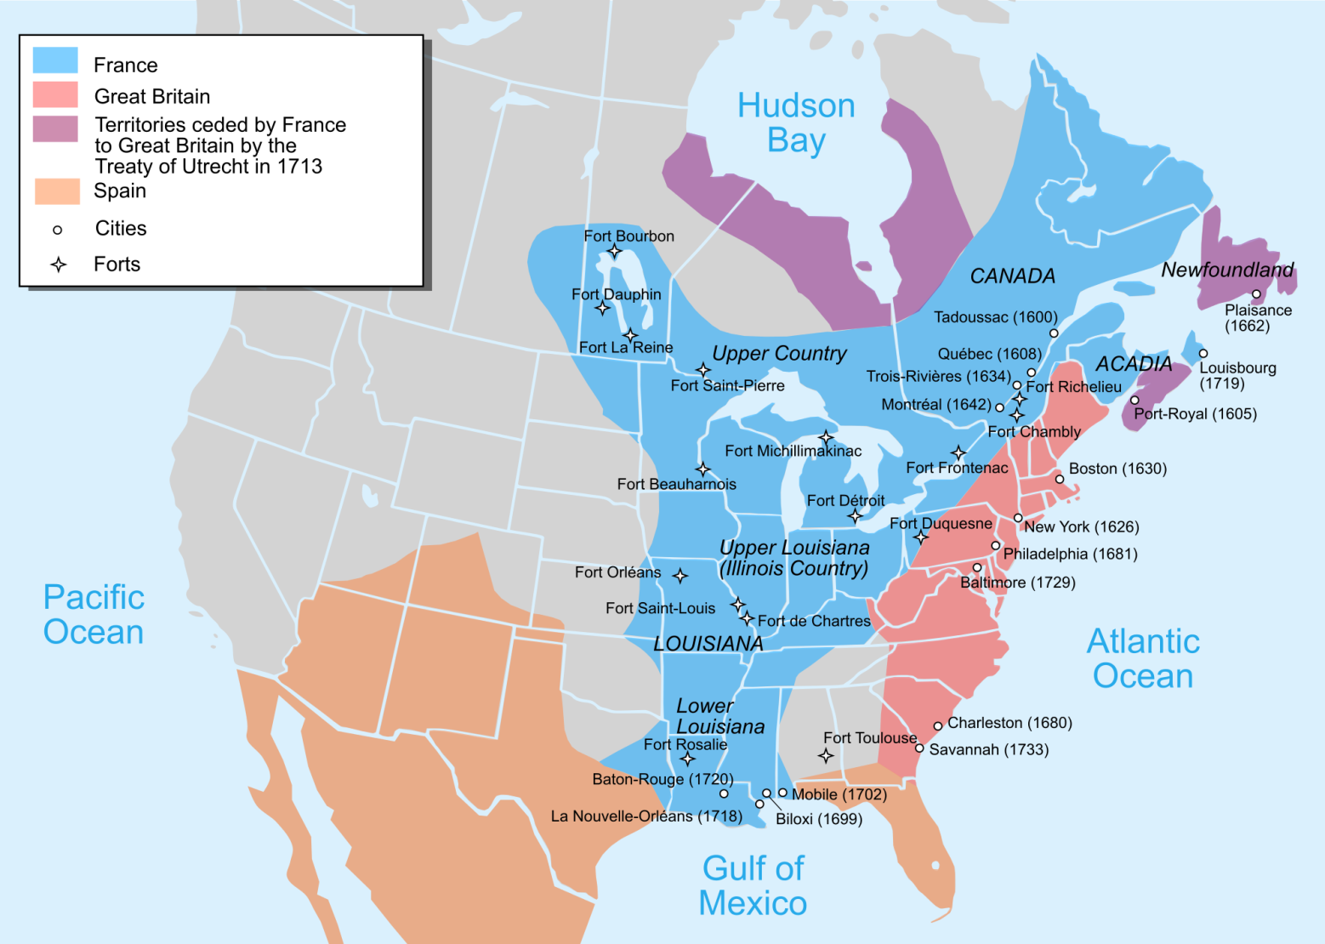
Social Classes in the Colonies
North America at Mid-Century

